Slide 1
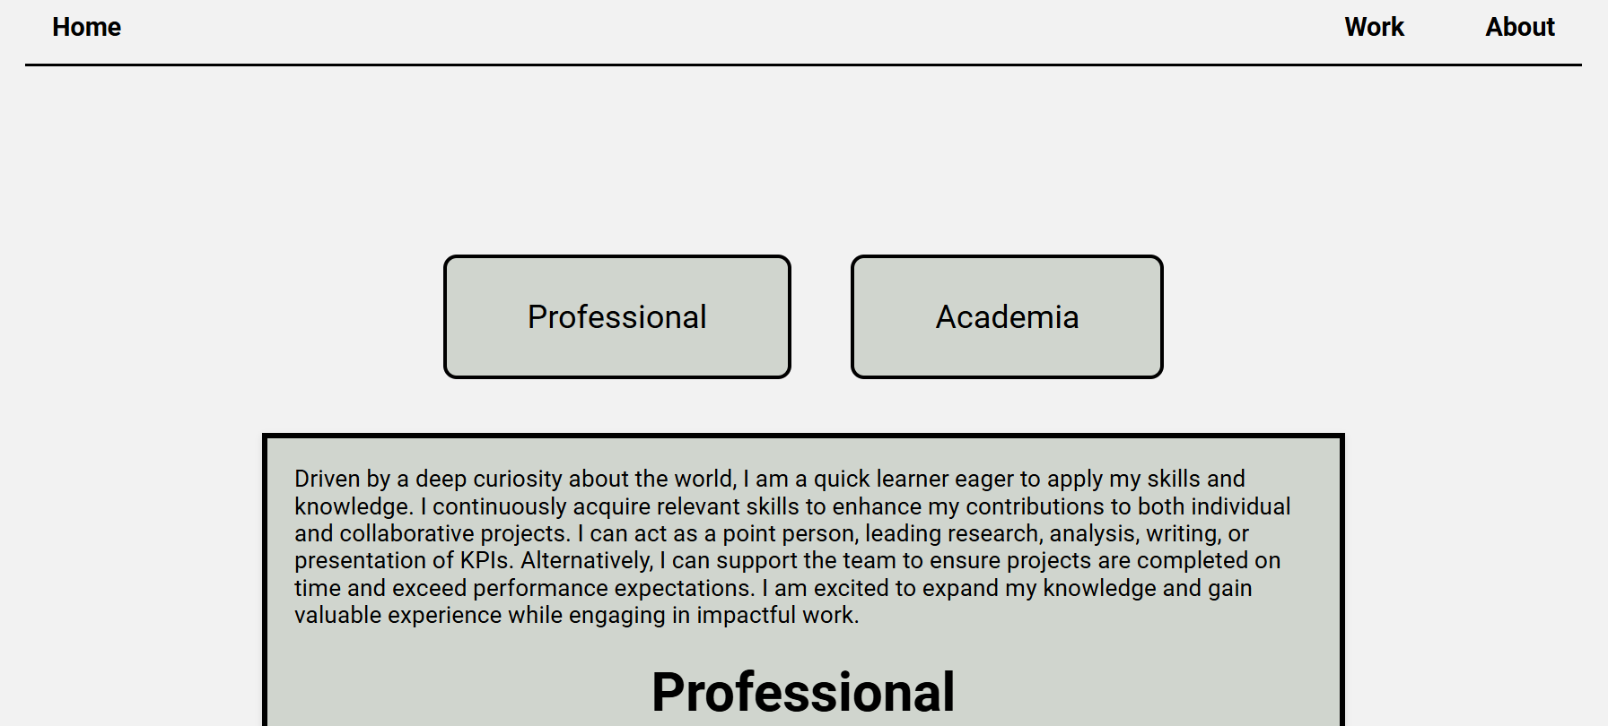
V1: Background: f2f2f2 Container: D0D5CE

Slide 2
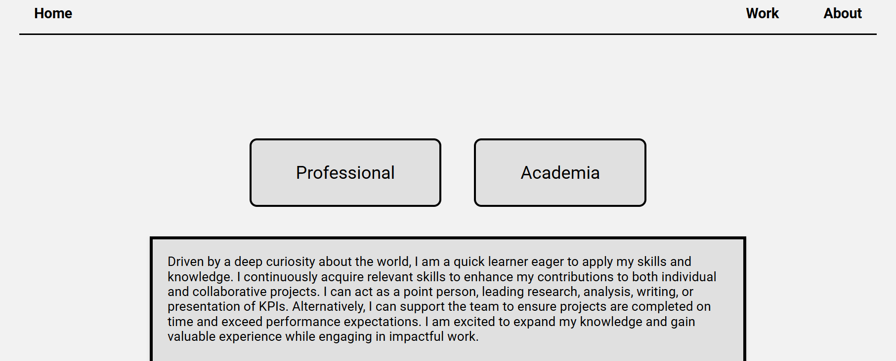
V2: Background: f2f2f2 Container: E0E0E0

Slide 3
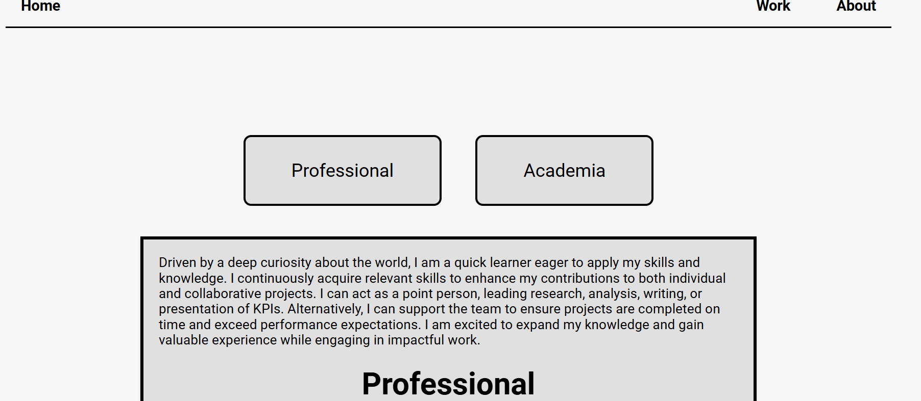
V3: Background: f7f7f7 Container: D0D5CE

Slide 4
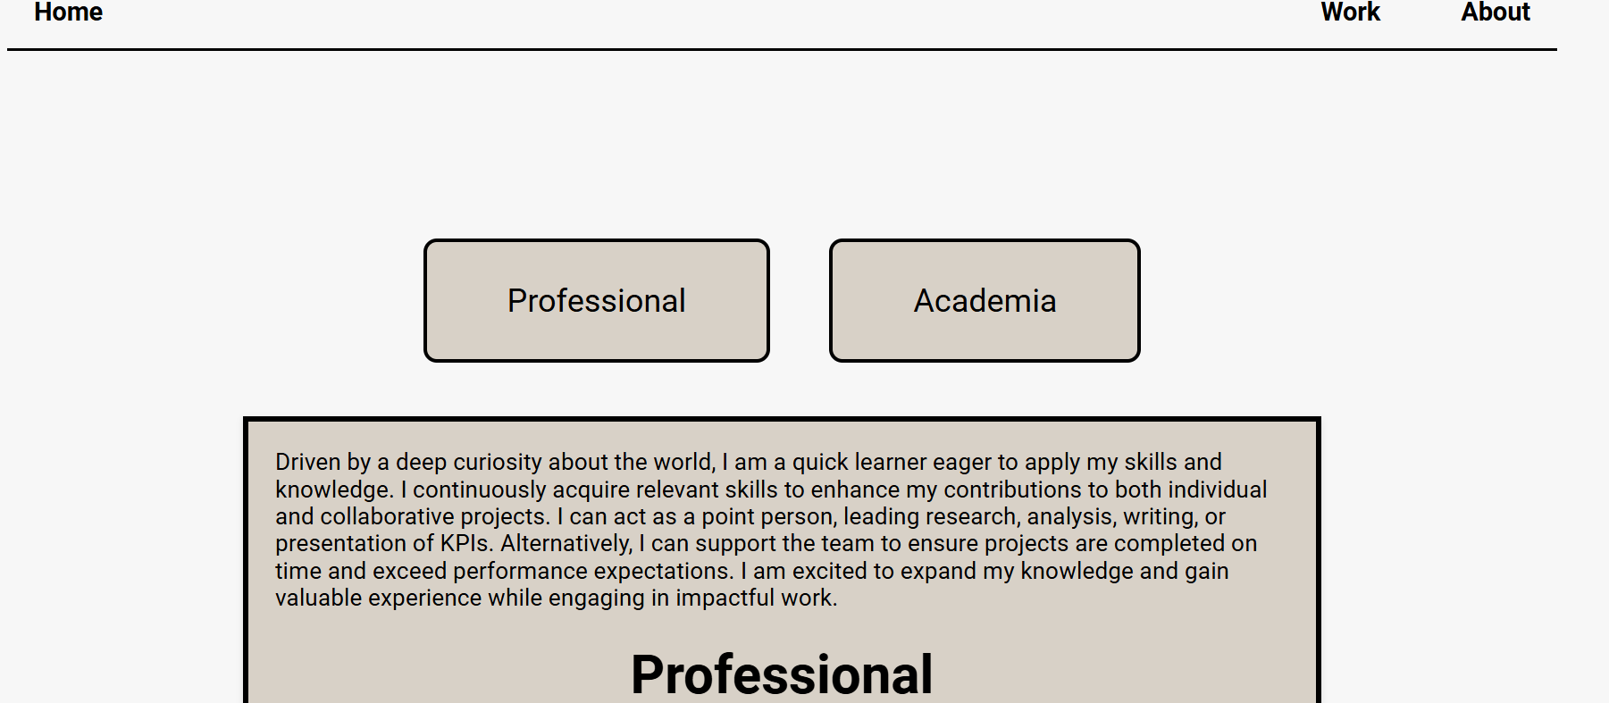
V4: Background: f7f7f7 Container: D9D1C7

Slide 5
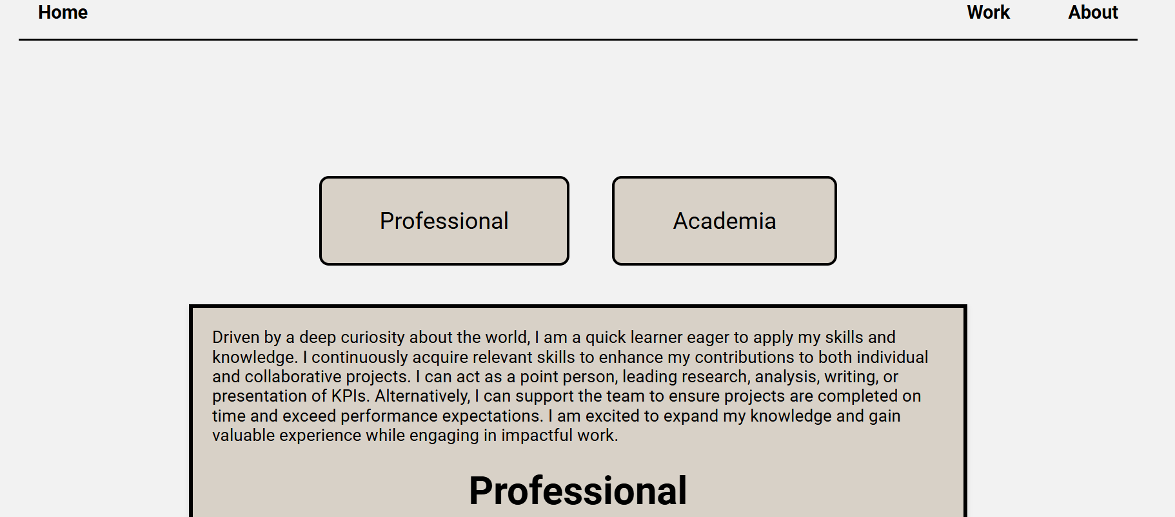
V5: Background: f2f2f2 Container: D9D1C7

Slide 6
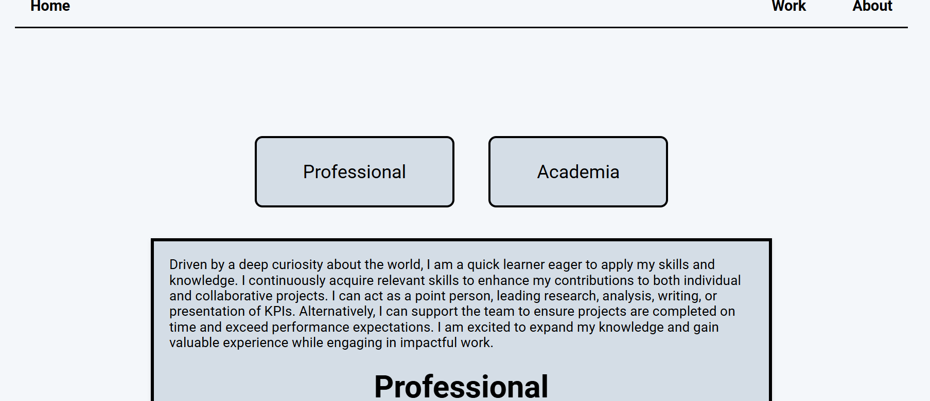
V6: Background: F4F7FA Container: D3DDE6

Slide 7
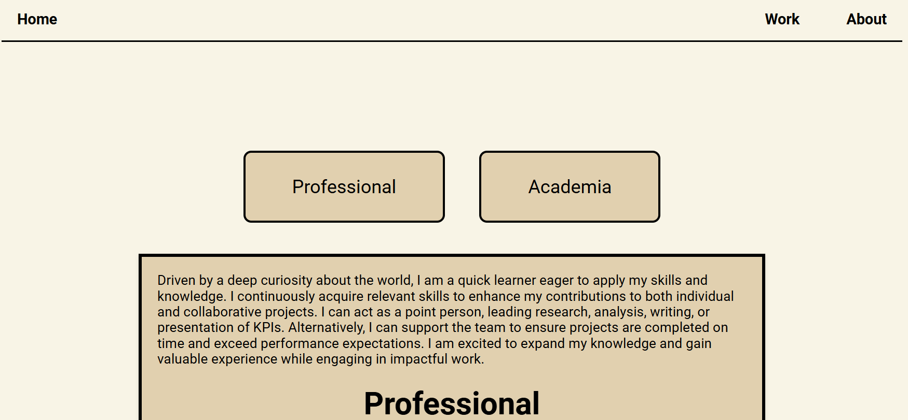
V7: Background: F8F4E6 Container: E2D1B0

Slide 8
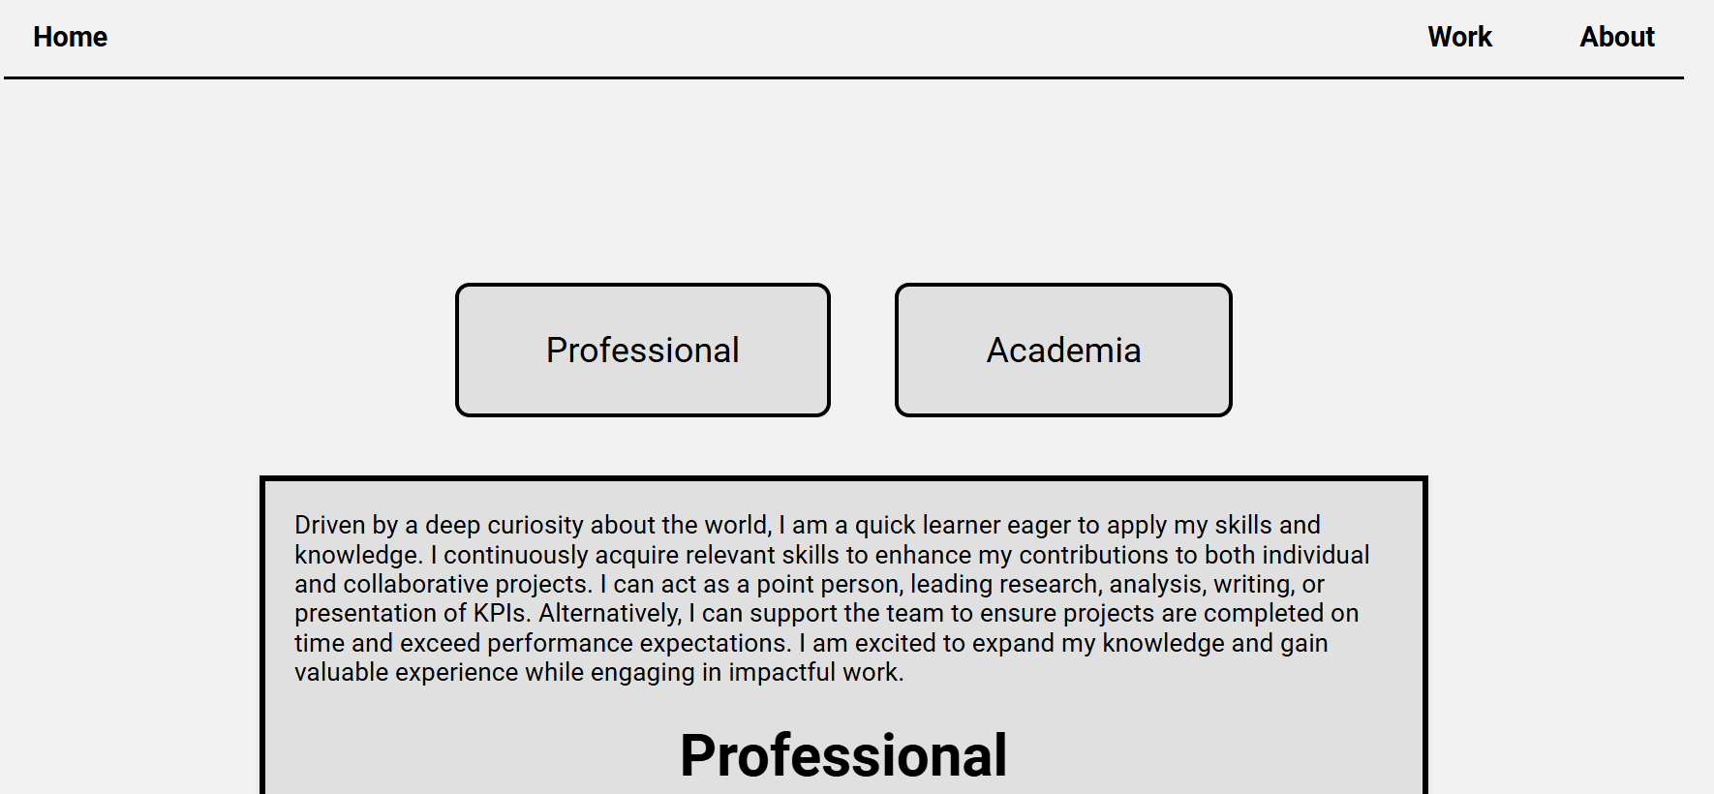
V8: Background: f2f2f2 Container: bfbfbf

Slide 9
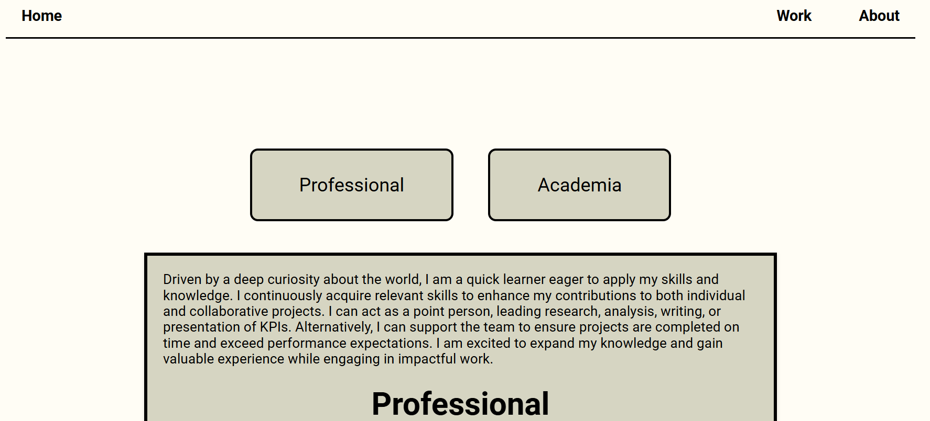
V9: Background: FFFDF5 Container: D6D5C3

Slide 10
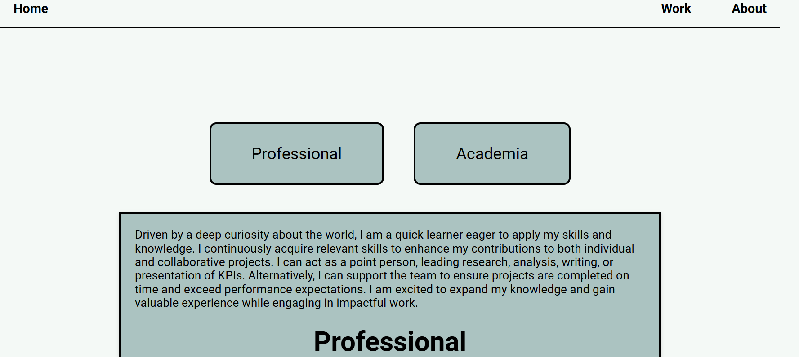
V10: Background: F3F9F6 Container: A8C3C1

